Slide 1
Online Clinic Management System
Web Application using PHP

Slide 2
Team Details
Ayan Sharma
Lakhan Prajapat

Slide 3
Introduction
“Online clinic management system” is to manage the management system of the clinic. The main objective is to develop the software that covers all the aspects of the management and operations of clinics. It enables healthcare providers to improve operational effectiveness, reduce costs, reduce medical errors, reduce time consumption and enhance the delivery of quality of care.

Slide 4
Technologies Used
Front End
HTML
CSS
Bootstrap
Back End
MySQL
Server-Side Programming
PHP
Server
Xampp

Slide 5
Project Application
LOGIN
On login page, the person have to fill the username and unique password and has to press the submit button.
Admin Login
The admin have to fill the username and unique password and has to press the submit button to access admin area.
Admin login can access the full system and can add or delete employees as well.

Slide 6
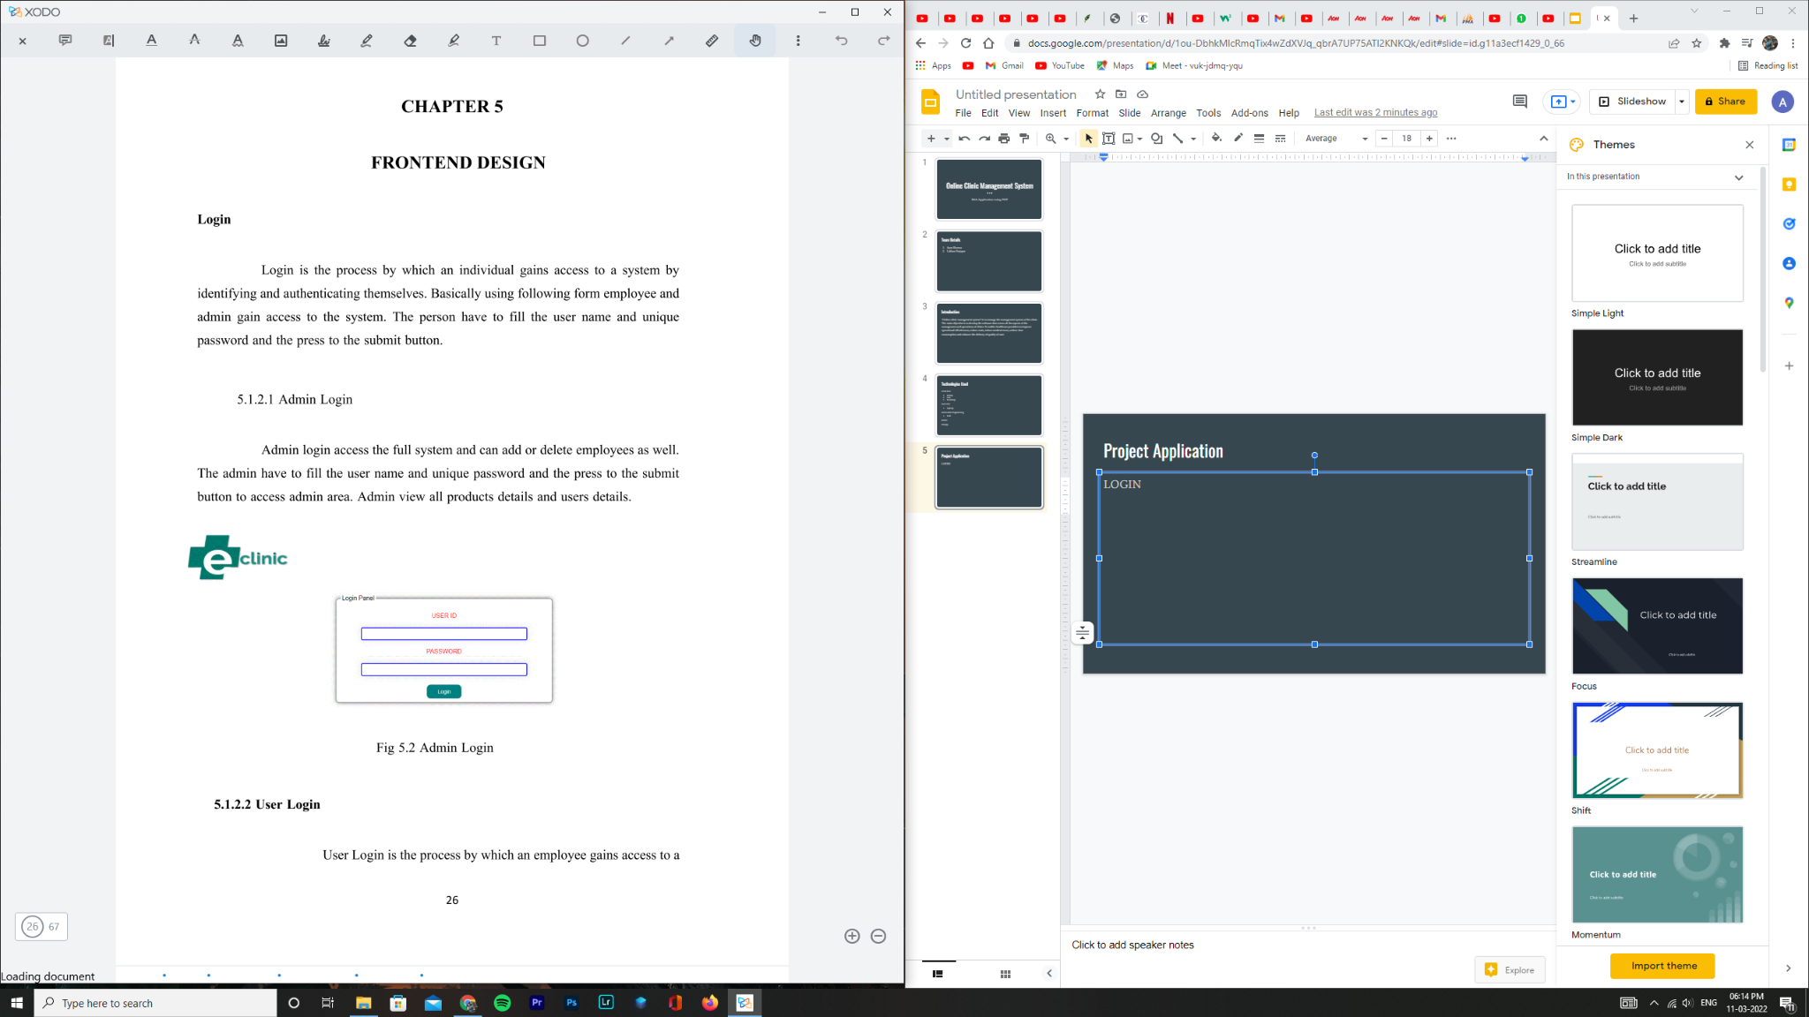

Slide 7
2. User Login
The user have to fill the username and unique password and the press to the submit button.
User Login is the process by which an employee gains access to a computer system by identifying and authenticating themselves.

Slide 9
PATIENT REGISTRATION
To add a new patient we are required to fill the given form which contain Username, email, contact number, and address and then submit it.

Slide 10
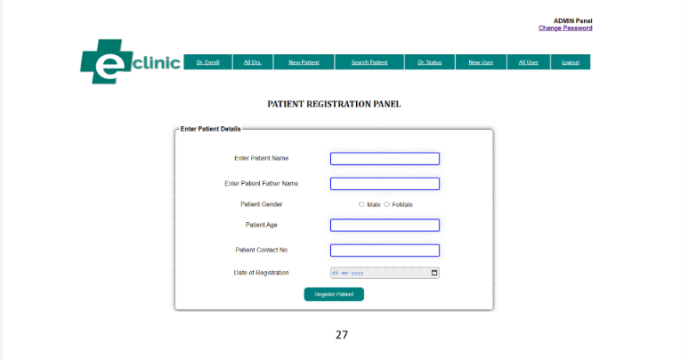

Slide 11
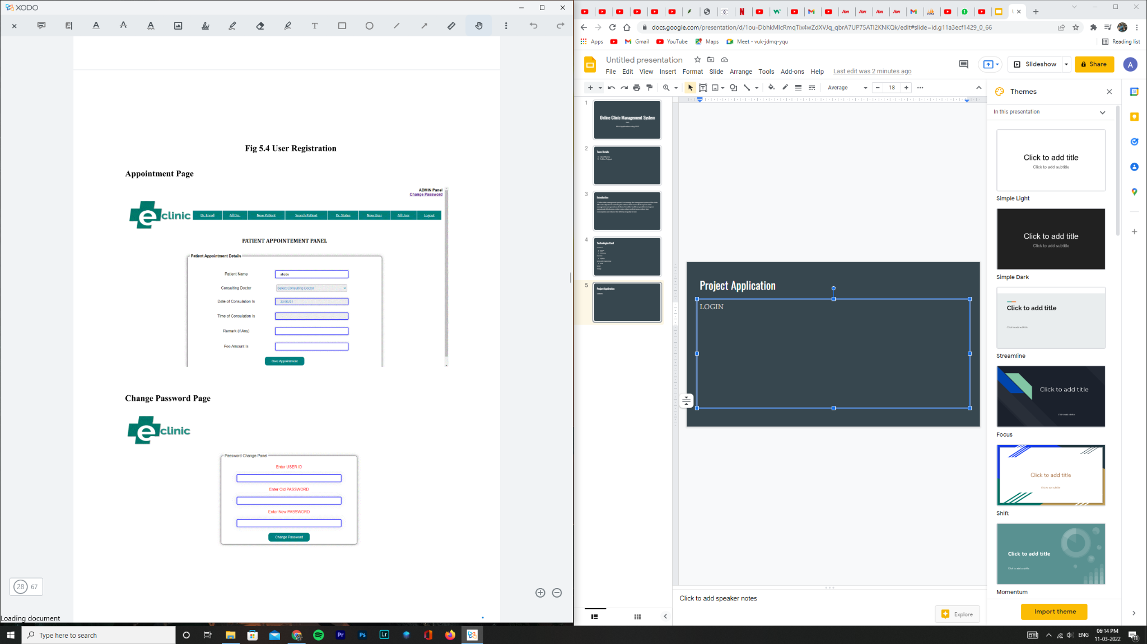
Appointment Page

Slide 12
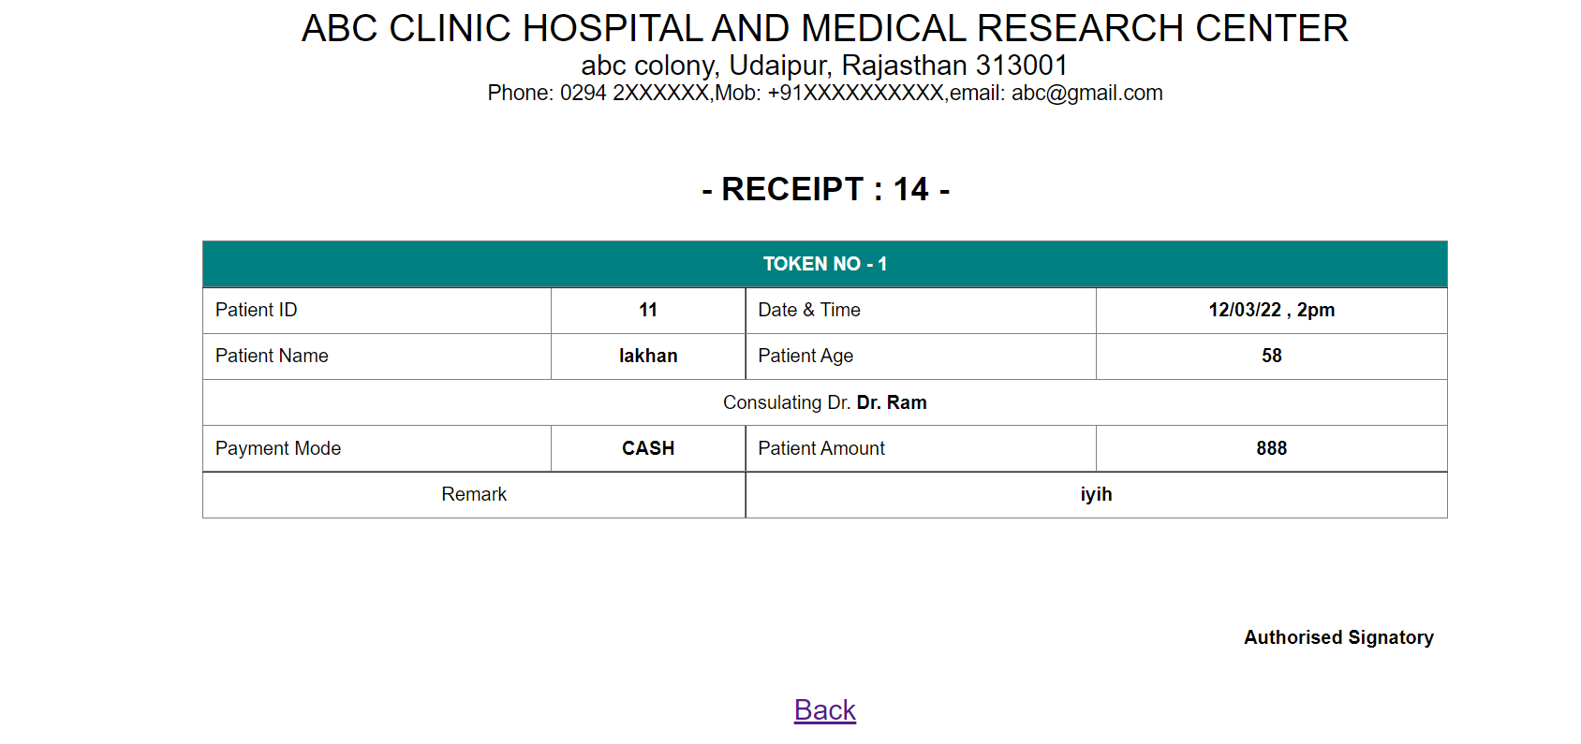
PATIENT’S RECEIPT

Slide 13
Change Password

Slide 14
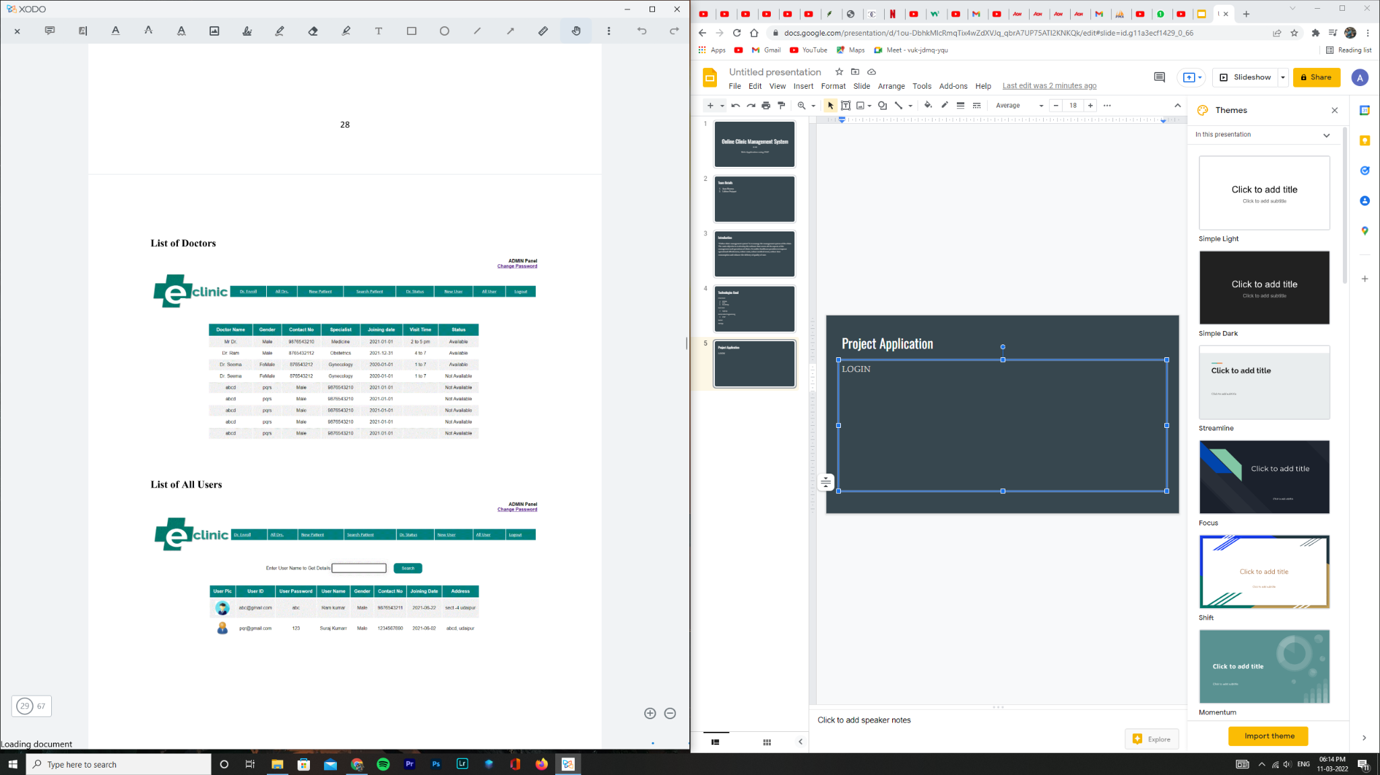
List of All Doctors

Slide 15
List of all Users

Slide 16
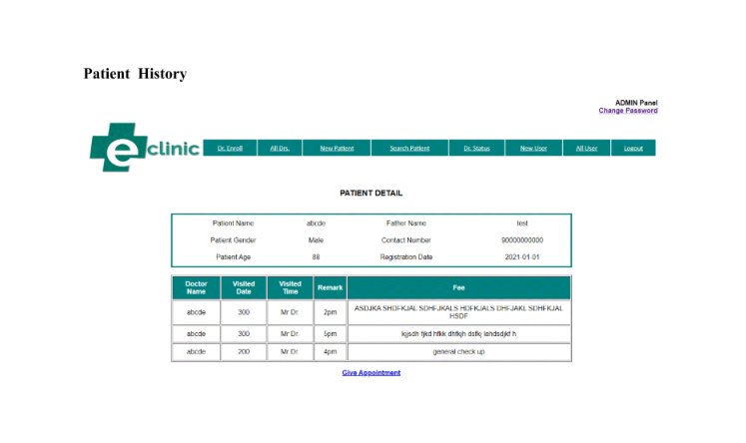
Patient History

Slide 17
Future Scope
The scope of the project includes that what all future enhancements can be done in this system to make it more feasible to us:
SMS features: If patient takes appointment or treatment SMS goes to Patients Cell Phone.
Medical Store: Medical Store Administrator can view suggested prescription through online by entering polyclinic patient ID.
● Patients can view reports, billing, etc
● Consumes less time and reduces human errors.
● Doctors can view patient’s old reports.
● Medical store administrator can view suggested prescription through online by entering patients ID.
● User friendly.

Slide 18
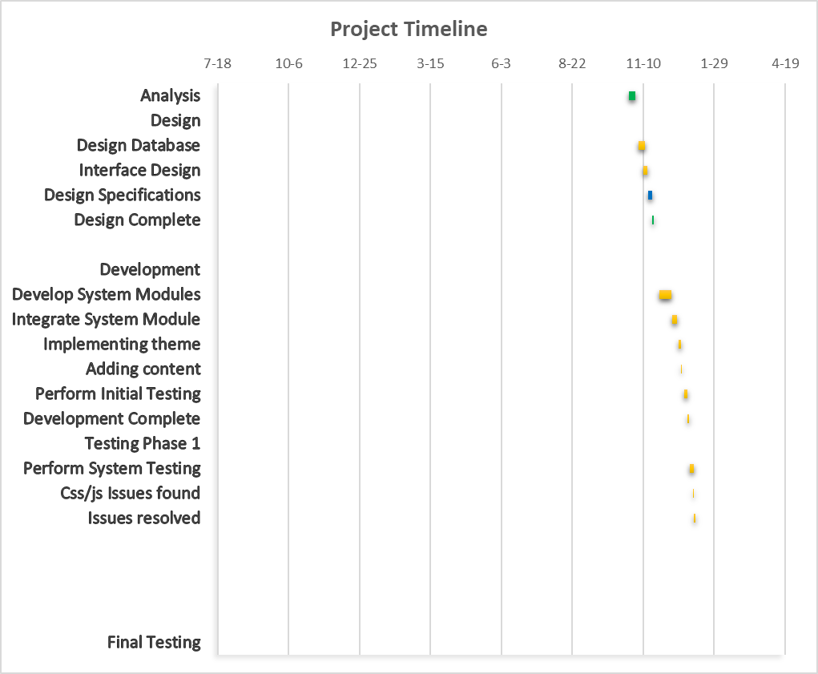

Slide 19
Advantages
The system is helpful as it generates a systematic overall report of every class attendance.
It excludes the use of paper work and human efforts.
It saves user time, cost and institute resources.
The system introduces a manageable and systematic approach of maintain patients records.

Slide 20
Disadvantages
There should also be a Wi-Fi or internet connection available.
The only disadvantage is that every user requires a device to access the system

Slide 21
THANK YOU

